Slide 1






PROJECT 420
SUBMITTED TO PROFESSOR MAJID AMIRFAKHRIAN
Team Members: Chika Udeozor
Damian Ozobokeme

Slide 2




SUPPLEMENTS SALES DATA ANALYSIS

Slide 3




BUSINESS UNDERSTANDING

Slide 4




CASE STUDY
•The Online Retail company wants to have a better understanding of which products drive revenue, which customers are most valuable, and how returns affect performance.
•With the use of R programming language, we explored the dataset, cleaned it, and created predictive models, and visualized the outcomes.
•Insights gotten will help management make decisions around promotions, stocking, and customer retention strategies.

Slide 5






INTRODUCTION
•The Online Retail dataset consists of real e-commerce transactions from a wholesaler based in the UK. Each invoice includes quantities, prices, product information, customer IDs, and return indicators.
•Our goal is to apply Predictive Analytics in R to answer two business questions related to sales patterns, customer behaviour, and product performance.

Slide 6

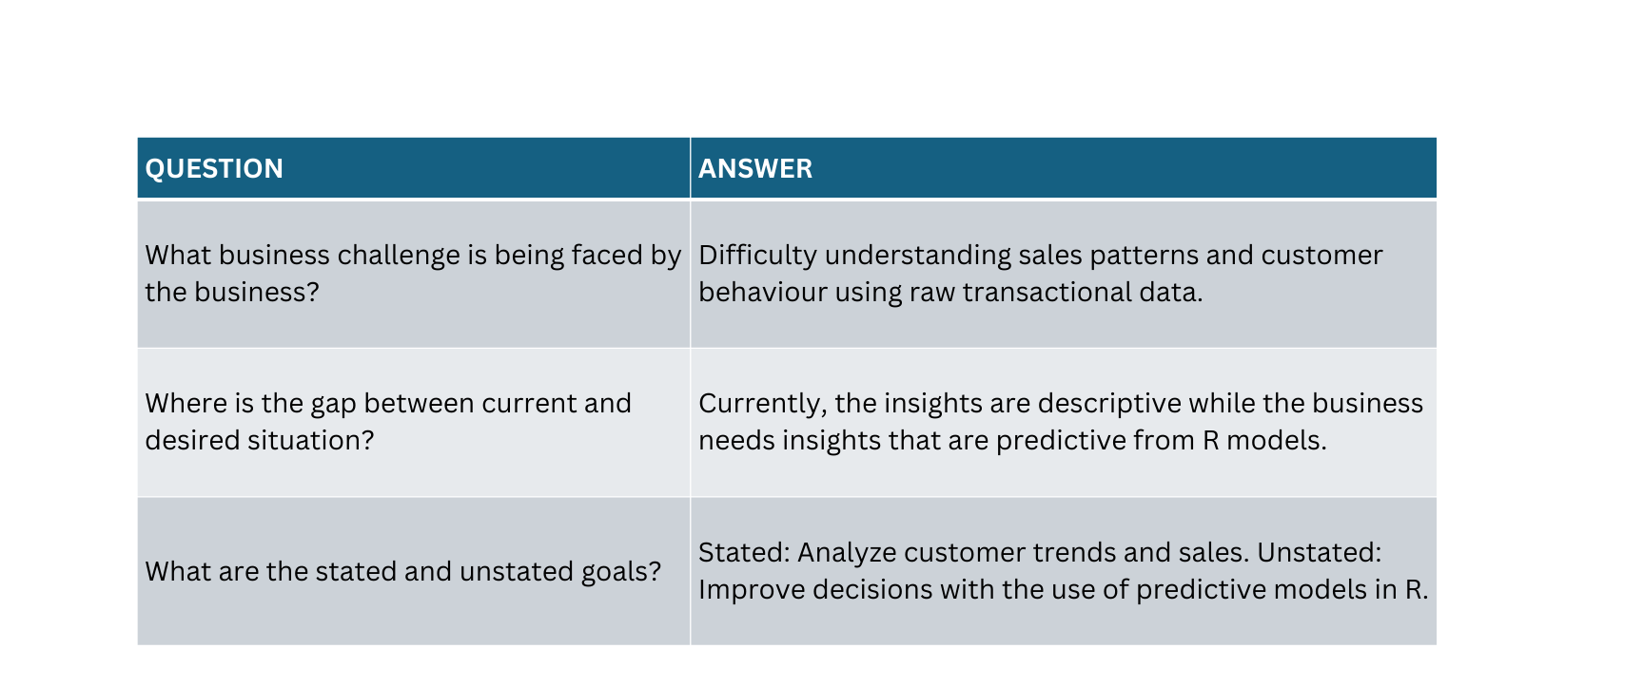


6-STEP ANALYSIS
STEP 1: EXPLORING THE MESS

Slide 7
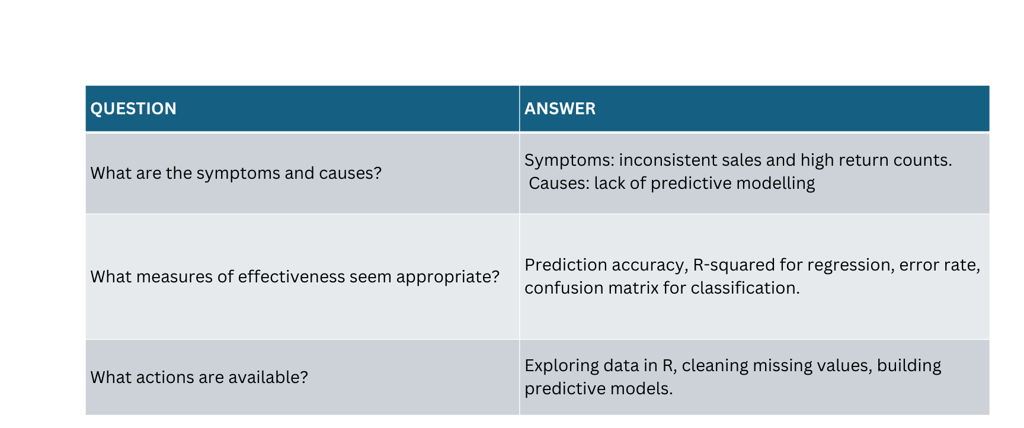
6-STEP ANALYSIS
STEP 2: SEARCHING FOR INFORMATION

Slide 8
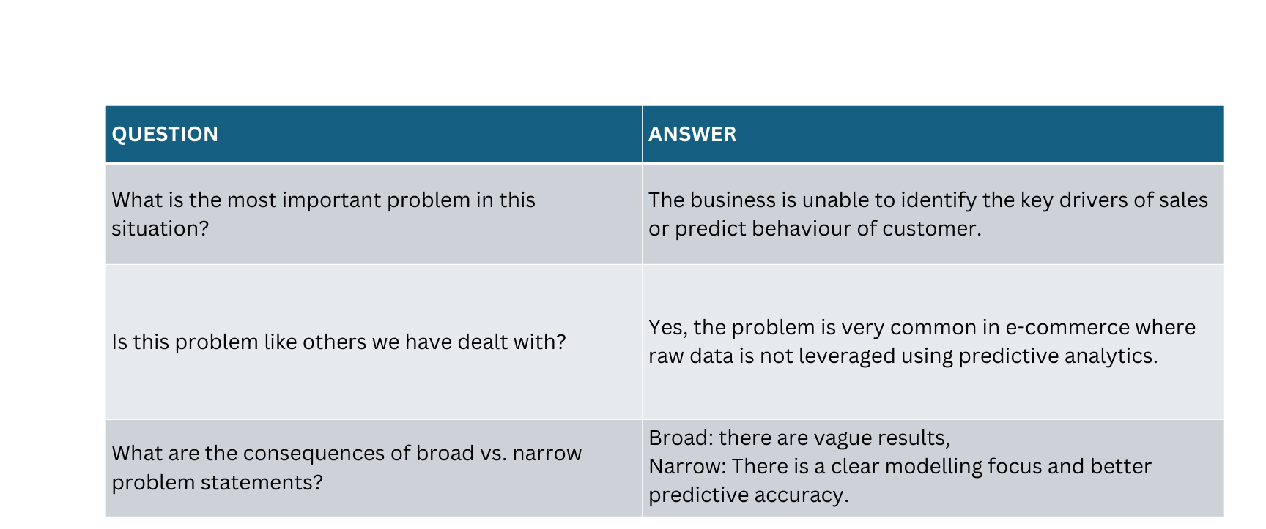
6-STEP ANALYSIS
STEP 3: IDENTIFYING THE PROBLEM

Slide 9
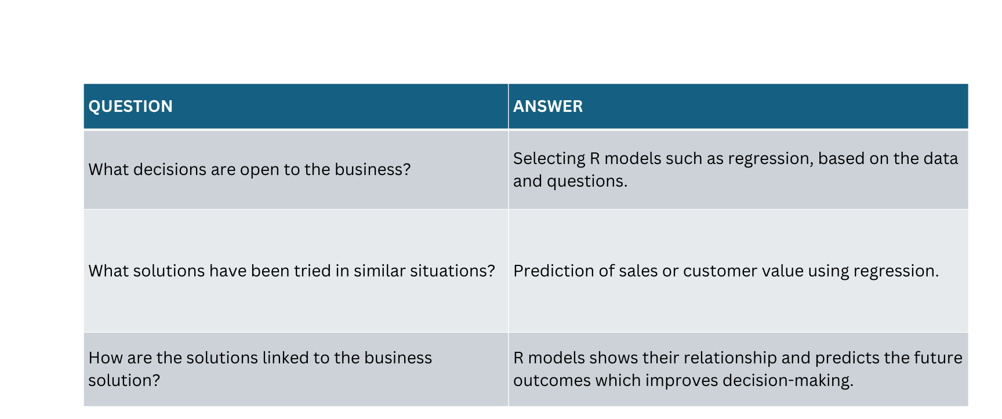
6-STEP ANALYSIS
STEP 4: SEARCHING FOR SOLUTION

Slide 10
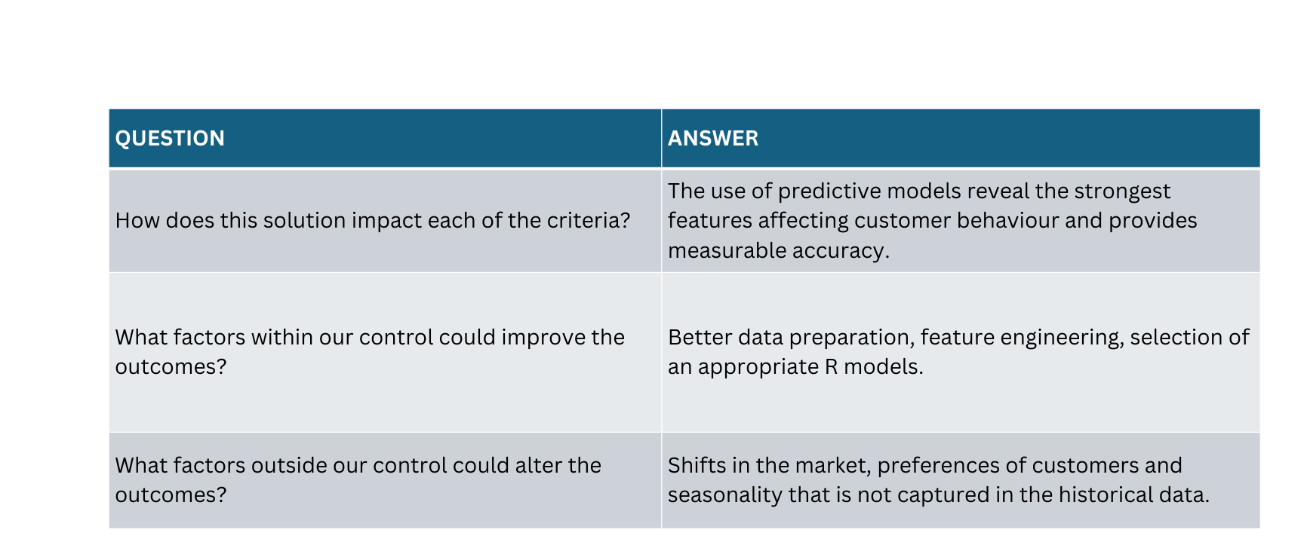
6-STEP ANALYSIS
STEP 5: EVALUATING THE SOLUTION

Slide 11
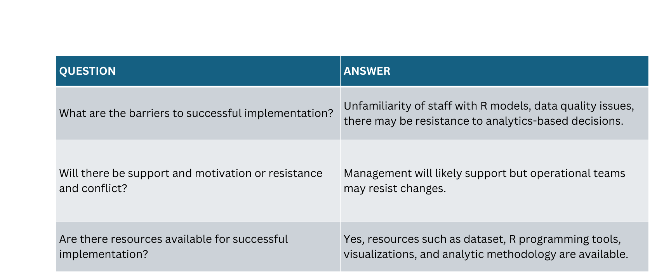
6-STEP ANALYSIS
STEP 6: IMPLEMENTING THE SOLUTION

Slide 12

DATA DICTIONARY
FIELD NAME | DATA TYPE | DEFINITION
Price | Decimal | Unit Price
Date | Date | The date when the sales was recorded
ProductID | Int | The unique identifier for each product
ProductName | VarChar | The name of the product that was sold
Category | VarChar | The Category of the Product
Platforms | VarChar | The Sales Platform such as Online, Mobile-App or in-store
Units Returned | Int | Number of unit returned
Location | VarChar | Store or sales location
UnitsSold | int | The number of units sold in the transaction.
Revenue | Decimal | Sales revenue for the row
Discount | Decimal | Discount applied to each product

Slide 13


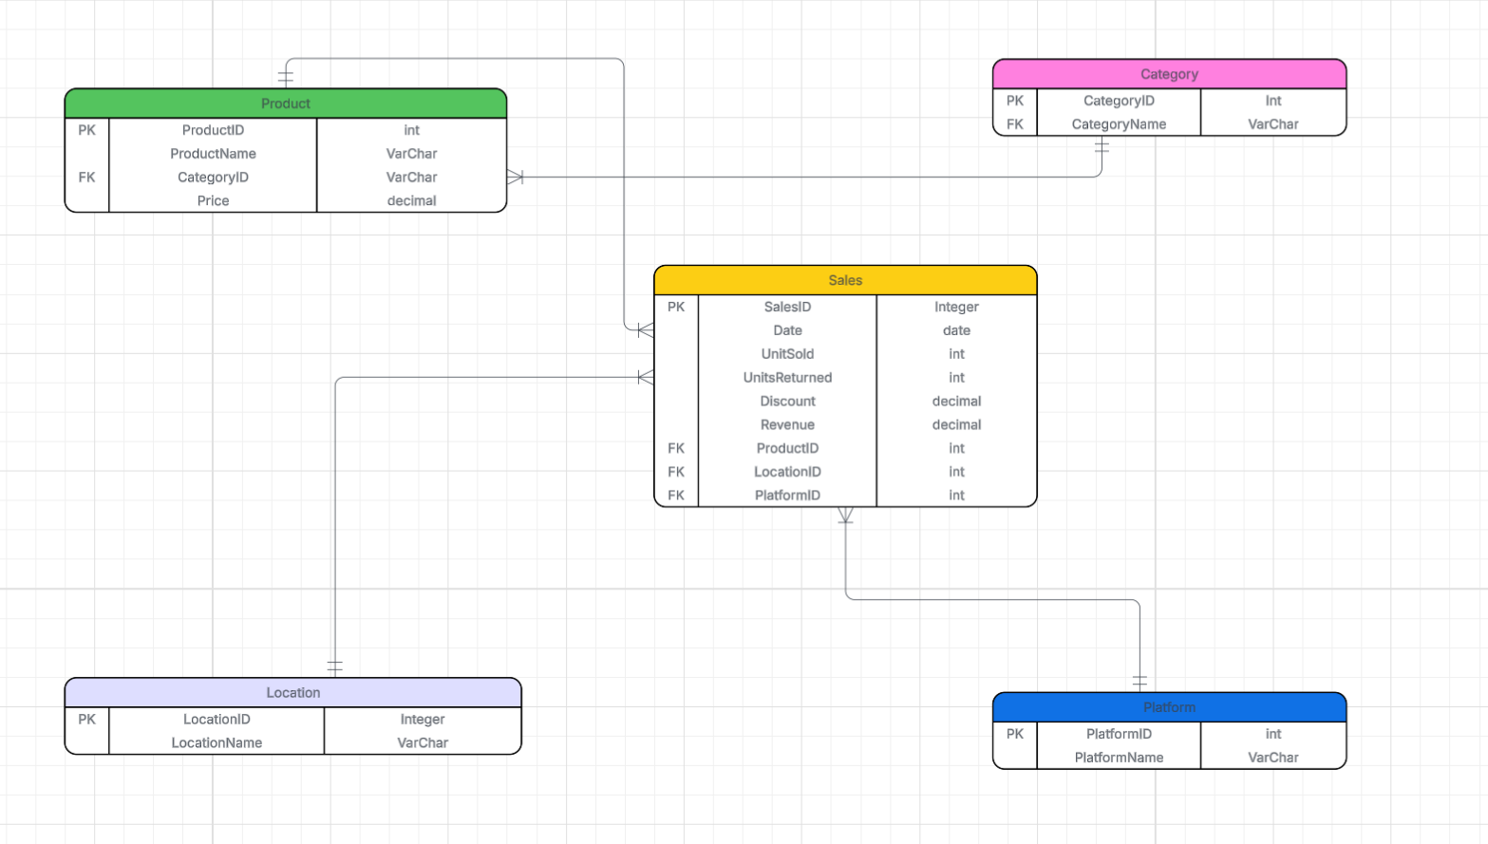




ERD MODEL
SHOP

Slide 14
ERD MODEL
Category to Product (1: many).
One category can contain many products, but each product belongs to only one category
2. Product to Sales (1: Many)
One product can appear in many sales records, but each sales record refers to one product
3. Location to Sales(1: Many)
One location can generate many sales records
4. Platform to Sales (1: Many)
One platform can be associated with many sales.

Slide 15
DATA CLEANING USING R PROGRAM

Slide 16

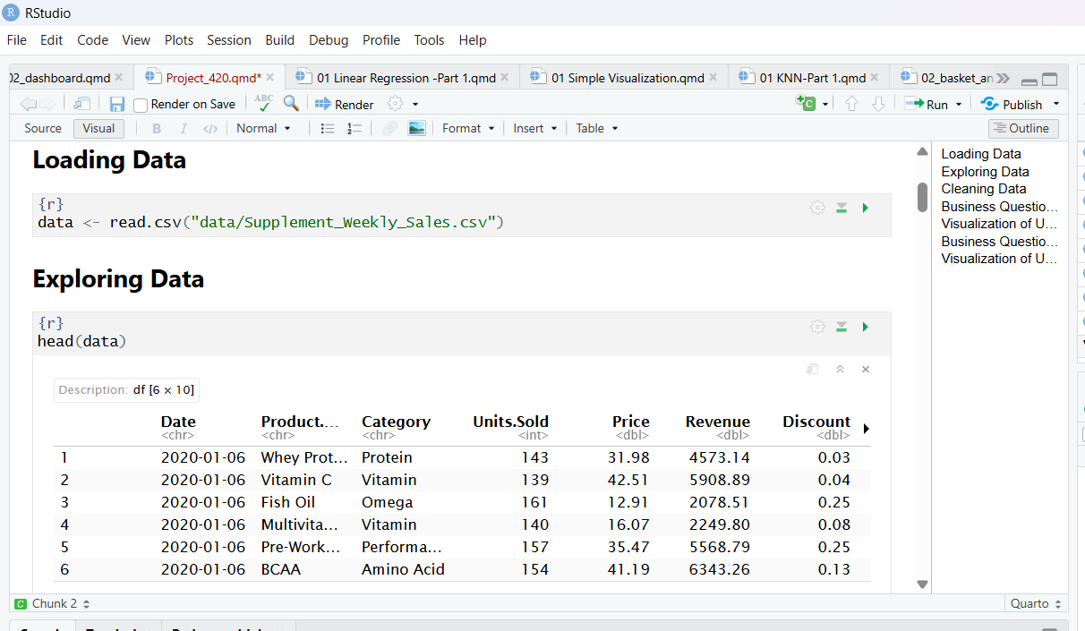



LOADING DATA IN ‘R’

Slide 17
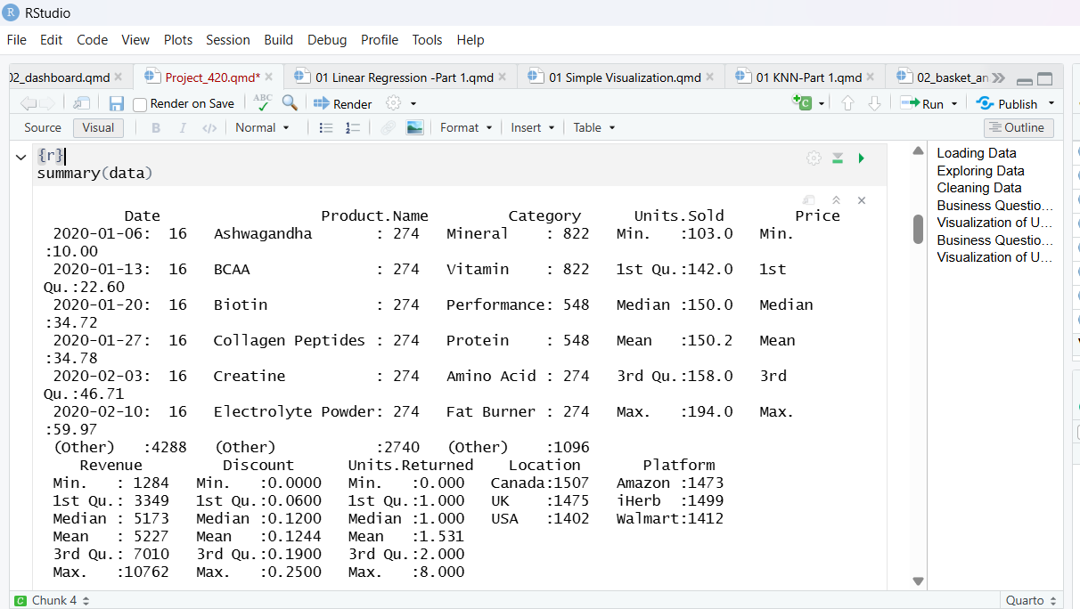
EXPLORING DATA

Slide 18
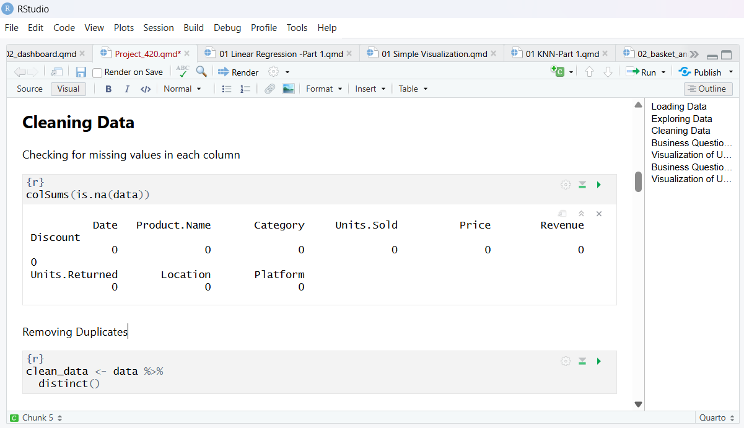
CLEANING DATA

Slide 19
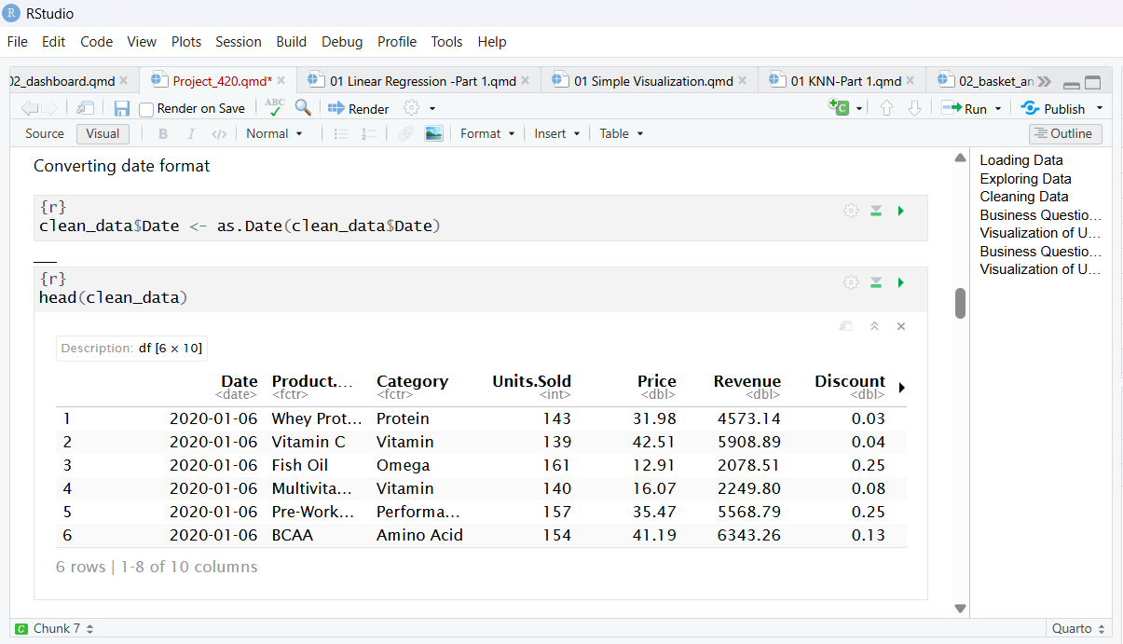
CLEANED DATA

Slide 20




BUSINESS QUESTION 1
“GIVEN UNITS SOLD AND DISCOUNT FOR EACH PRODUCT, CAN WE PREDICT WEEKLY REVENUE TO BE GENERATED?”
@reallygreatsite

Slide 21

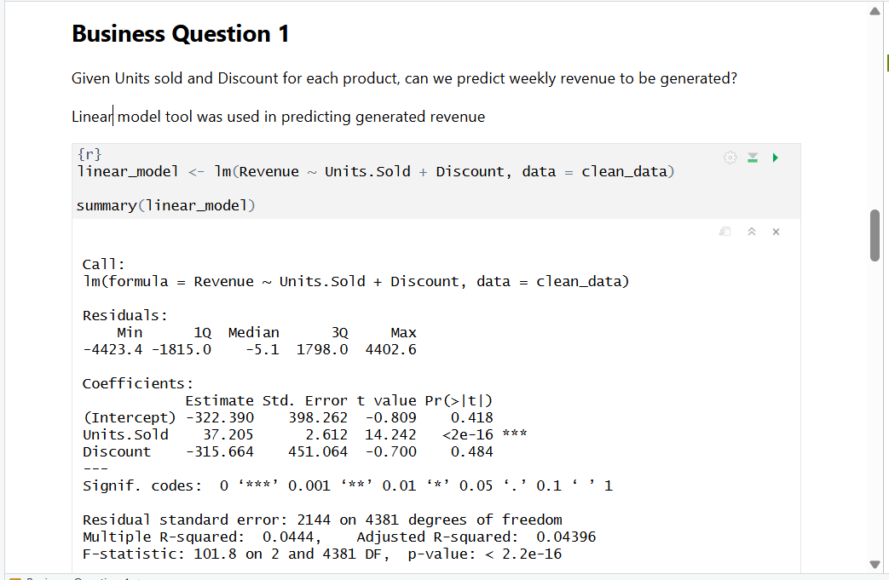
MULTIPLE REGRESSION MODEL
The units sold co-efficient is ~ 37.
This means that for each extra unit of product sold, the weekly revenue increases by approximately $37 on average whle keeping discount constant.
The intercept is -322.390 which is not statistically significant and R-Squared value is 0.0444 thus showing that discount by itself does not change revenue generated.

Slide 22
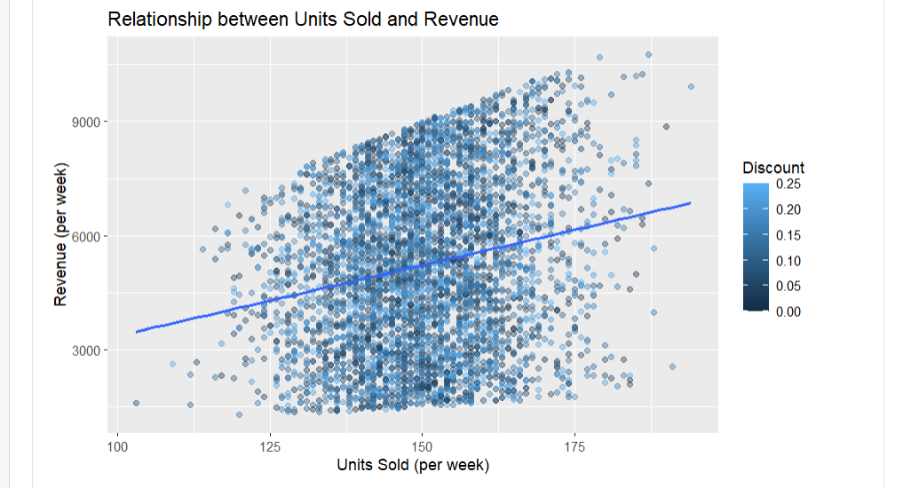
VISUALIZATION USING SCATTER PLOT
From the scatter plot, it is noted that there is moderate positive correlation between units sold and revenue whilst taking into account discount on each product.

Slide 23
BUSINESS QUESTION 2
“CAN WEEKLY REVENUE BE PREDICTED FROM PLATFORM AND LOCATION (WHILE TAKING INTO CONSIDERATION UNITS SOLD)?”
@reallygreatsite

Slide 24
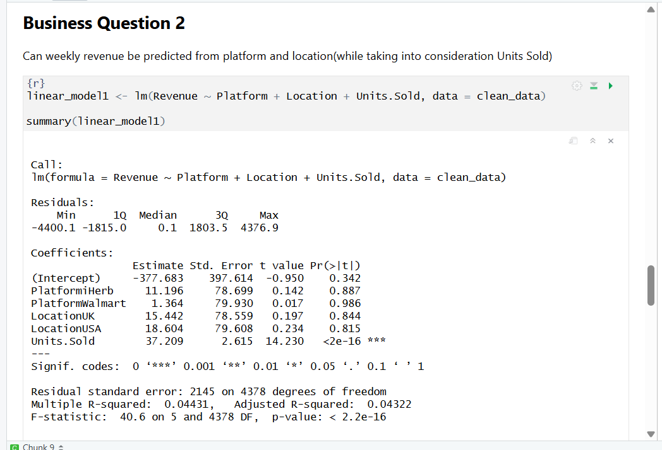
MULTIPLE REGRESSION MODEL
The linear model shows an intercept of -377.683 which is not statistically significant.
The platform co-efficient for iHerb is ~ 11.20 while co-efficient for Walmart is ~ 1.36 against baseline category of Amazon Platform.
Location co-efficient for USA is ~ 18.60 while UK co-efficient is ~ 15.44 against baseline category of Canada location.

Slide 25
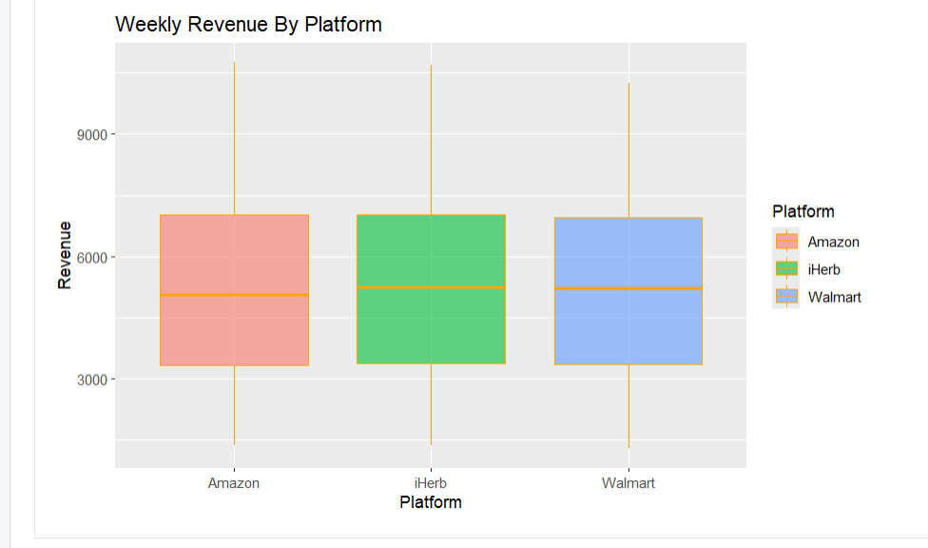
VISUALIZATION USING BOX PLOT
After taking into consideration units sold, the revenue generated by the platforms is not meaningfully different from each other.
Hence the platform used by the customers does not meaningfully influence revenue to be generated by the business.

Slide 26
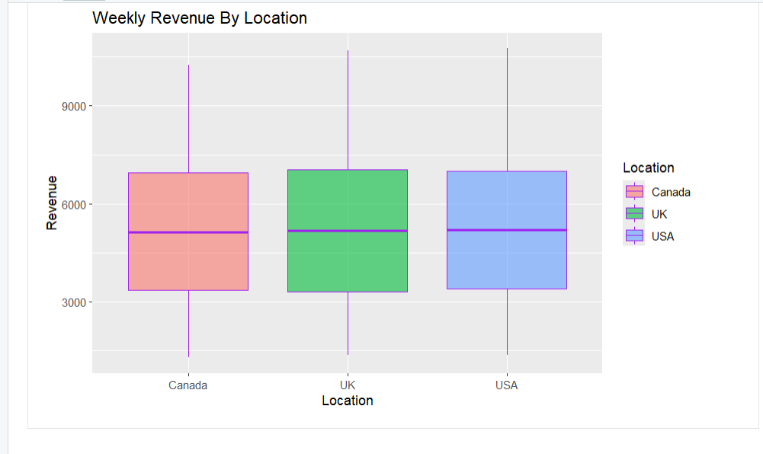
VISUALIZATION USING BOX PLOT
After taking into consideration units sold, the revenue generated by the locations is not meaningfully different from each other.
Hence the location from which customers order for products does not meaningfully influence revenue to be generated by the business.

Slide 27




CONCLUSION
The business should concentrate on growing the number of units sold since this is the only significant source of income, according to the predictive study.
Inventory and marketing tactics can continue to be divided equally among these groupings because platform and location have little impact on revenue generated.
Discount tactics have a poor predictive influence on sales volume, so they should be used with caution.
In general, rather than switching platforms or geographical markets, the focus should be on increasing sales volume and operating strategy.

Slide 28



REFERENCES
Mughal, Z. (2024). Supplement Sales Data [Data set]. Kaggle. Mughal, Z. (2024). Supplement Sales Data [Data set]. Kaggle.
OpenAI. (2025). ChatGPT [Large language model]. https://chat.openai.com/

Slide 29



THANK YOU

Slide 30
ANY QUESTIONS?

